Slide 1


MACROMOLECULE Jeopardy-1
Category 1 | Category 2 | Category 3 | Category 4 | Category 5
10 | 10 | 10 | 10 | 10
20 | 20 | 20 | 20 | 20
30 | 30 | 30 | 30 | 30
40 | 40 | 40 | 40 | 40
50 | 50 | 50 | 50 | 50

Slide 2

Reaction that joins monomers by removing water
Dehydration synthesis or condensation
Notes:
Category 1 - 10

Slide 3
Reaction that splits polymers by
Adding water
hydrolysis
Notes:
Category 1 - 20

Slide 4
DAILY DOUBLE
C₂₀H₄₀O₂₀ is probably what
type of molecule?
carbohydrate

Slide 5
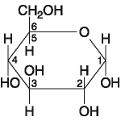
One of these is probably a what?e
monosaccharide

Slide 6
What specifically is lactose?
Disaccharide.

Slide 7
Glycogen, starch, cellulose, chitin are all
what? (specifically)
polysaccharides

Slide 8
Starch and cellulose are both
polymers of glucose but differ in the
glycosidic linkages.
What are the two types of linkages?
Alpha and beta

Slide 9
What linkage does starch
have that our enzymes are able
to hydrolyze?
alpha

Slide 10
C₃₆H₇₂O₄ is probably a what?
lipid

Slide 11
What group is insoluble in water,
an important part of membranes,
and contain energy?
lipid

Slide 12
A lipid made of a glycerol and 3
Fatty acids?
triacylglycerol

Slide 13
What fats have double bonds and
Are liquid at room temperature?
unsaturated

Slide 14
What fat has hydrogen added to it to
Make it solid at room temperatue?
Trans fat

Slide 15
Lipid that has 4 fused rings
steroid

Slide 16
What makes the 20 different amino acids
Different?
R group (side chain)

Slide 17
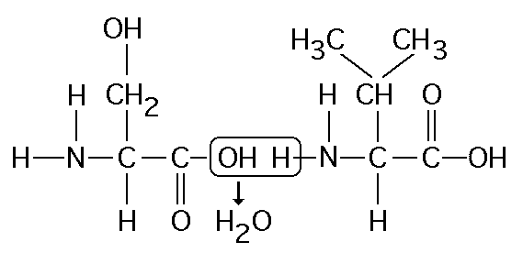
Forming of a peptide bond between 2 amino acids

Slide 18
Peptide, esther, etc…are all what
Types of bonds?
covalent

Slide 19
If there are 400 amino acids in a
Protein, how many peptide bonds?
399

Slide 20
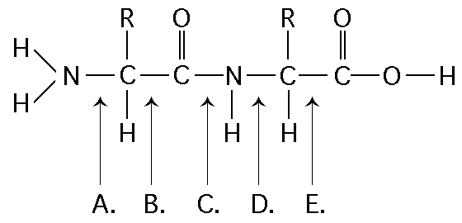
Where is the peptide bond?
c

Slide 21
What bonds create the primary structure of a protein?
Peptide bonds

Slide 22
What bonds create the secondary structure of a protein?
Hydrogen bonds

Slide 23
What bonds create the tertiary
structure of a protein?
Covalent, ionic, disulfide bridges, H bonds, VanderWaal

Slide 24
What part of the protein chains
are involved in tertiary bonds?
R groups

Slide 25
What are the two common secondary protein forms?
Alpha helix and beta pleated sheets

Slide 26
Altering which level of structure
of a protein could alter its function?
All of them!

